Slide 1

CMR COLLEGE OF ENGINEERING & TECHNOLOGY
Kandlakoya, Medchal, Hyderabad - 501401
Department of Computer Science and Engineering- Cyber Security
Real Time Research Project
PRC — 2

Slide 2
Outline
CMR COLLEGE OF ENGINEERING & TECHNOLOGY
Kandlakoya, Medchal, Hyderabad - 501401
Department of Computer Science and Engineering- Cyber Security
UNVEILING USER INTERACTION FOR KEYLOGGER ANALYSIS
Name of the Students and Roll Numbers:
1. G. Sachurya — 21H51A6209
2. M .Archana – 22H51A6204
3. A. Ashmitha — 22H51A6206
Under esteemed guidance of
T.Raju
Assistant Professor
CSE — Cyber Security

Slide 3
Outline
Abstract
Introduction
Literature Review
Existing Solutions
Problem Definition
Advantages
Methodology
Flow Chart
Architecture
System Requirements
Results
Conclusion
References
Notes:
3

Slide 4
Abstract
Protecting sensitive information's privacy is the main aspect on which our project will be working on, and it has become critical in an era marked by the exponential growth of data-driven technology.
Our project, “Homomorphic Encryption” delves into the world of cutting-edge advanced cryptographic techniques to protect user privacy while allowing data computations on encrypted data.
It allows complex mathematical operations to be performed on encrypted data without needing to decrypt it.
Homomorphic encryption provides a potential method for performing computations on encrypted data without having to decrypt it, safeguarding privacy, confidentiality and data integrity.
This project considers the principles and practical implementations of homomorphic encryption, demonstrating its potential to revolutionize secure data processing in a variety of domains such as healthcare, finance, cloud computing, and so on.
Notes:
4

Slide 5
Abstract
The cause of the keylogger characteristic described on this paper is to reveal and file using the programs on the laptop system. The software makes use of the Python programming language and libraries such as pynput, smtplib, pyautogui, and OpenCV. The important features of this keylogger include taking pictures keystrokes, shooting timestamps, viewing energetic window titles, typing search queries, and appearing actions with right mouse clicks. The keylogger runs in the heritage and captures all keystrokes by means of the user, including letters, places, and input key presses. Timestamps are recorded to test the timing of each keystroke. In addition, the program retrieves the title of the active window to offer a description of the keystroke. It also lists the phrases or queries that the user searched for. In addition, the keylogger is programmed to take a screenshot of the display screen and locate a right mouse click on and take a photo of the consumer with a web browser and then e mails those screenshots and pictures to the designated recipient.

Slide 6
Introduction
In traditional encryption, data must be first encrypted to secure it. Decryption of data must happen before any computations can take place. This decryption step poses a significant security risk as it exposes sensitive information to potential threats.
However, homomorphic encryption presents a groundbreaking solution to this problem.
It is an advanced cryptographic technique that enables computations to be performed directly on encrypted data, eliminating the need for decryption.
This revolutionary approach not only ensures data privacy and confidentiality but also opens new avenues for secure data processing.
Homomorphic encryption exists in many types, from partially to fully homomorphic encryption, each with its own computational capabilities while keeping data hidden.
Its diverse applications span secure cloud computing, privacy-preserving data analysis, and confidential machine learning.
Notes:
6

Slide 7
Introduction
Keyloggers are covert software programs designed to surreptitiously record keystrokes on a computer or mobile device.
Operating discreetly in the background, they capture every keystroke made by a user, including sensitive information like passwords, usernames, and credit card numbers.
Malicious actors exploit these tools to perpetrate various illicit activities, such as stealing sensitive information for identity theft, financial fraud, and other cybercrimes.
Moreover, state actors and intelligence agencies may employ keyloggers as tools of espionage to clandestinely gather sensitive information from targeted individuals or organizations, raising significant concerns regarding privacy infringement and civil liberties.
Notes:
7

Slide 8
Literature Review
Jing Li, Xiaohui Kuang, Shujie Lin, Xu Ma, Yi Tang, “Privacy preservation for machine learning training and classification based on homomorphic encryption schemes”, 2020 (Science Direct)
When a machine learning system is trained or classified in the cloud environment, the cloud server obtains data from the user side.
The use of scheme to realize privacy preservation for machine learning training and classification.
The analysis shows that our homomorphic encryption is efficient for encryption/decryption to preserve privacy of users and user’s data.
M. Mohan, K. Devi, Jeevan Prakash, “Homomorphic encryption-state of the art”, 2017 (IEEE)
Homomorphic Encryption has become a viable method for privacy preservation. It basically deals with the computations of encoded data.
Homomorphic encryption scheme allows operations on encrypted data which, when decrypted will provide the same results as we performed directly on the raw data.
Certain cryptographic algorithms having the homomorphic property.
Notes:
8

Slide 9
Literature Review
“A Systematic Literature Review on Windows Malware Detection Techniques“(2019) : Authors(Karbab and Debbabi) Page: 14-27.
This review covers various malware detection techniques, including those used to detect keyloggers, focusing on their evolution and effectiveness.
"The Emerging Challenges of Wearable Biometric Cryptosystems“(2024): Authors(Khalid Al Ajlan,Tariq Alsboui) Page: 27-31.
This paper addresses the integration of biometric cryptosystems in wearable technology, highlighting encryption and data security techniques relevant to keyloggers.
"Multiple Time Servers Timed-Release Encryption Based on Shamir Secret Sharing for EHR Cloud System“(2024) :Authors( Ke Yuan, Ziwei Cheng, Keyan Chen)Page: 12-18.
This paper explores timed-release encryption techniques that can enhance data security in environments where keyloggers might be used.
Notes:
9

Slide 10
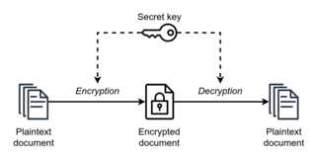
Existing Solutions
Symmetric Cryptography
Asymmetric Cryptography
Hybrid Cryptography
Symmetric cryptography:
Symmetric cryptography is also called as private-key cryptography.
It uses a same shared key for both encryption and decryption, making it efficient for data encryption.
Fig: Symmetric Cryptography Working
However, securely distributing and managing the shared key can be a challenge, which makes it suitable for local applications where key exchange is less of a concern.
Notes:
10

Slide 11
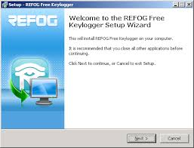
Existing Solutions
Refog Key Logger
Asymmetric Cryptography
Hybrid Cryptography
Refog Key Logger:
Refog Keylogger is a commercial software tool designed for monitoring and logging keystrokes on computers. It is developed by Refog Software and is primarily used for parental control, employee monitoring, and personal data security.
Notes:
11

Slide 12
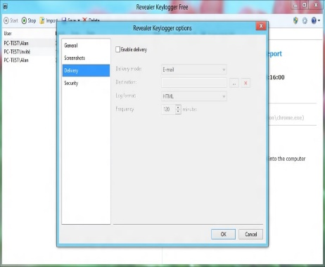
Existing Solutions
Symmetric Cryptography
Revealer Key Logger
Hybrid Cryptography
Revealer Keylogger:
A popular choice for users looking for a simple, free solution. It captures keystrokes and saves them to a local file.
Notes:
12

Slide 13

Existing Solutions
Symmetric Cryptography
Asymmetric Cryptography
Hybrid Cryptography
Hardware Key Capture Stand-alone Edition:
Hardware keyloggers are physical devices that capture keystrokes directly from the keyboard. Theyare typically placed between the keyboard and the computer.
Notes:
13

Slide 14
Problem Definition
In an era where the security of sensitive information is paramount, the limitations of traditional encryption methods have come to the forefront.
Traditional encryption require data decryption prior to computation or usage, pose significant privacy and security risks.
In some cases, they fall short in scenarios where data needs to be outsourced, processed in the cloud, or analyzed collectively, leaving confidential information exposed.
The emergence of homomorphic encryption offers a transformative solution by enabling computations on encrypted data without decryption, ensuring data privacy throughout the computation process.
Notes:
14

Slide 15
Problem Definition
The objective of this project is to enhance the functionality, security, and ethical standards of keyloggers, ensuring their effectiveness while addressing privacy concerns and promoting responsible usage. Current keyloggers face detection by antivirus software and security measures, which necessitates the development of sophisticated evasion techniques. Additionally, captured keystroke data is vulnerable to unauthorized access and data breaches, requiring robust encryption methods for both stored and transmitted data. Enhancing remote control features, including real-time monitoring and configuration options, will improve their usability and management in enterprise environments. Ethical and legal considerations are paramount, as keyloggers raise significant privacy concerns and potential for misuse. Establishing clear ethical guidelines and regulatory frameworks, promoting transparency, user awareness, and ensuring explicit consent for deployment are essential.

Slide 16
Advantages
Homomorphic encryption ensures data privacy during computation by allowing operations on encrypted data.
It reduces the risk of data breaches and thus enhancing overall security.
Homomorphic encryption facilitates secure data outsourcing.
It helps in meeting regulatory and compliance requirements in industries with strict data security regulations, such as healthcare and finance.
Notes:
16

Slide 17
Advantages
Stealthy Operation
Ease of Use
Comprehensive Data Capture
Standalone Functionality
Tamper-Resistant
Disadvantages:
As a company processes data of multiple users, homomorphic encryption can be resource-intensive, needing more hardware resources compared to existing encryptions. It can be a drawback in applications requiring high performance.

Slide 18
Methodology
Hardware
RAM — 8 GB
Storage — 512 GB
Processor — Intel i5 9th Gen
Software
Python (latest version is recommended)
Dependencies/Modules in Python
phe
Pyfhel
Notes:
18

Slide 19
Methodology
Key Features and Functionalities:
Keystroke Logging: The keylogger captures and records all keystrokes entered by the user, including letters, numbers, symbols, and special characters, providing a detailed log of textual input.
Timestamping:
Each keystroke is timestamped with the date and time of entry, allowing for precise timing analysis and chronological sequencing of user actions.
Window Title Retrieval:
The keylogger retrieves the title of the active window, providing context and description for each keystroke recorded, enabling better understanding of user interactions with different applications and programs.
Algorithm Name | Type of Homomorphic Encryption | Operations Supported
Paillier | Partially Homomorphic Encryption | Addition, Subtraction, Scalar Multiplication
BFV | Fully Homomorphic Encryption | Addition, Subtraction, Multiplication, Exponentiaion
CKKS | Fully Homomorphic Encryption | Addition, Subtraction, Multiplication
BGV | Fully Homomorphic Encryption | Addition, Subtraction, Multiplication, Exponentiaion
Fig: Algorithms used in our project

Slide 20
Methodology
Screenshot Capture:
The keylogger periodically captures screenshots of the computer screen, providing visual context and additional information about user activity and the content being accessed.
Mouse Click Logging:
The keylogger records mouse clicks, including right-click actions, offering a comprehensive view of user interactions with the graphical user interface (GUI).
Email Notification:
Upon capturing user activity, including keystrokes, screenshots, and mouse clicks, the keylogger sends email notifications to a designated recipient using the smtplib library, ensuring timely dissemination of surveillance data.

Slide 21
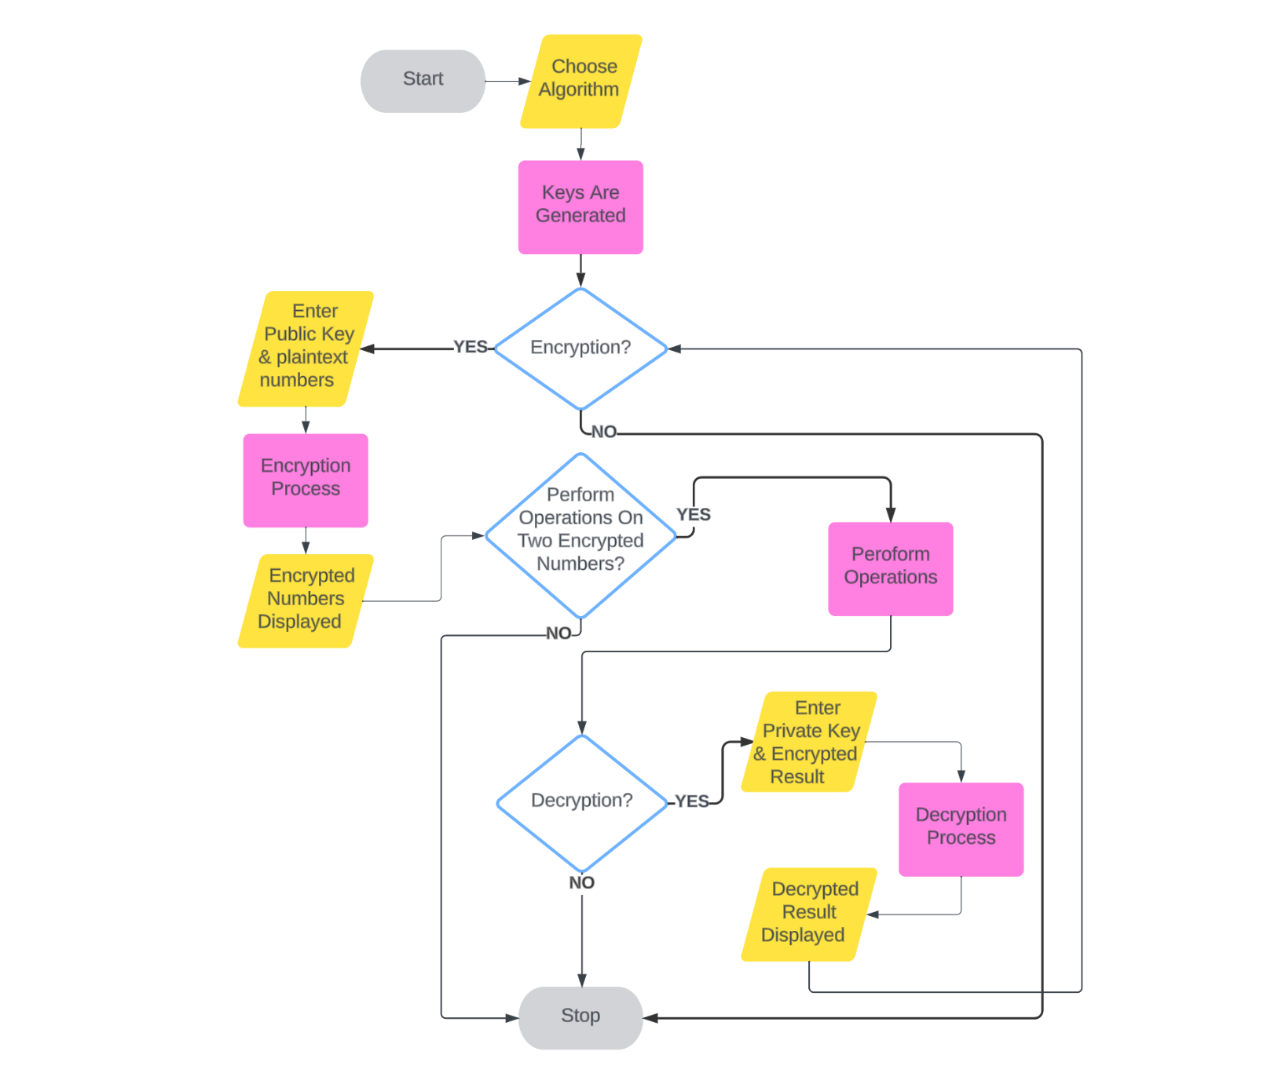
Flow Chart
Notes:
21

Slide 22
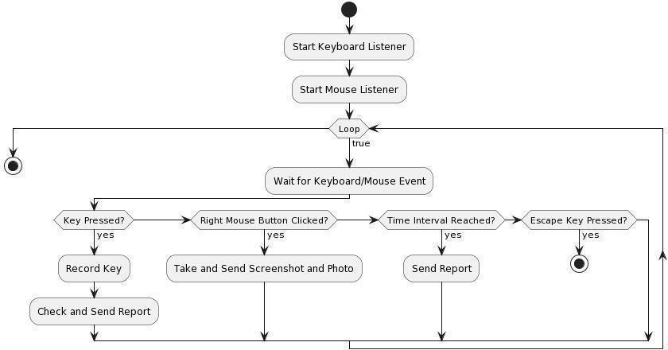
Flow Chart

Slide 23






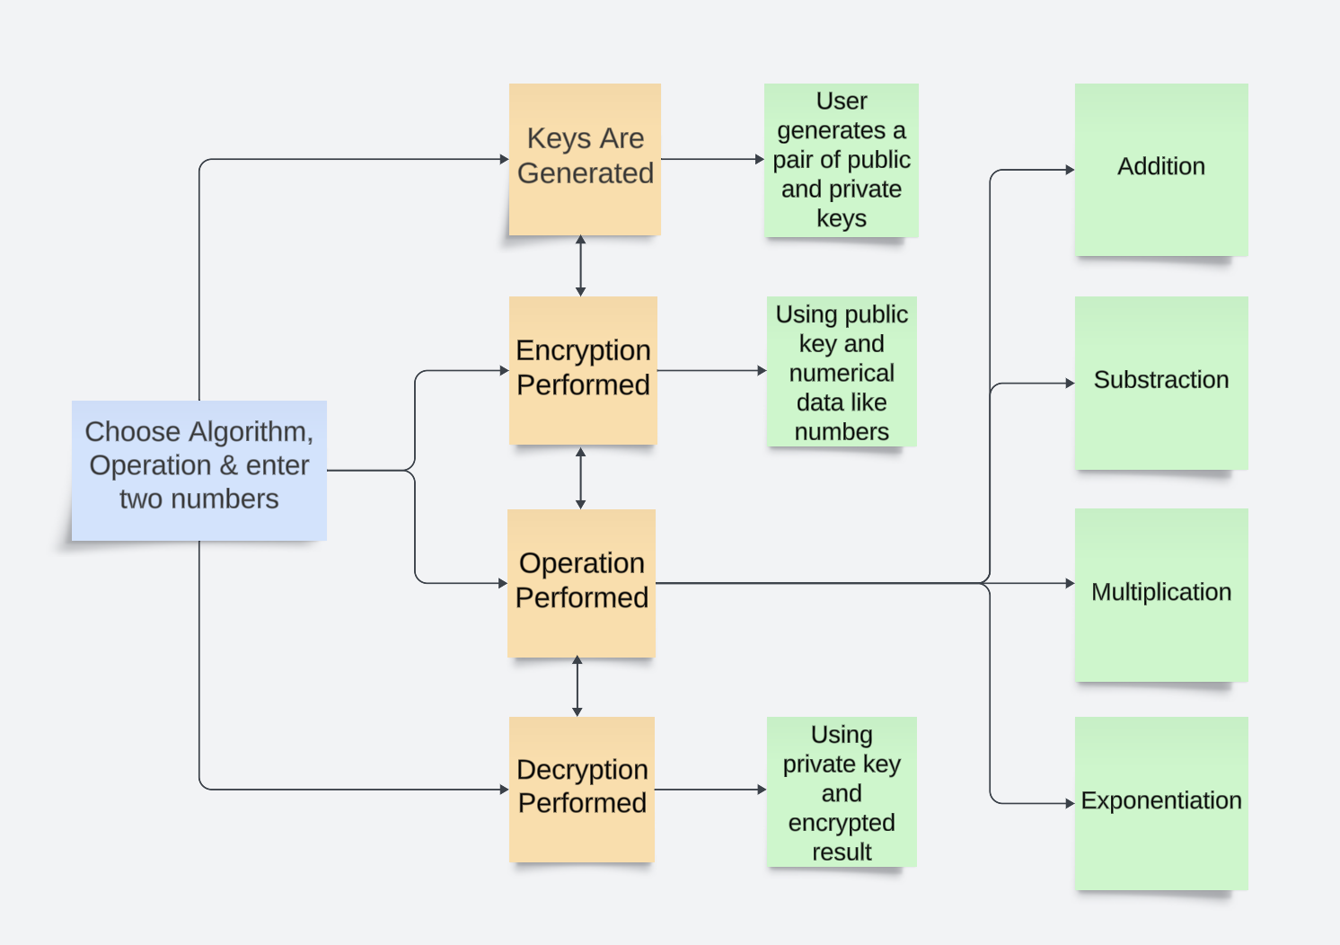
Architecture
Notes:
23

Slide 24
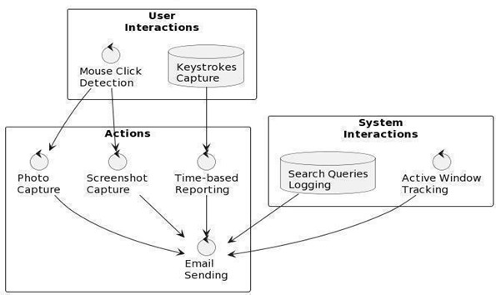

Slide 25
System Requirements
Hardware
RAM — 8 GB
Storage — 512 GB
Processor — Intel i5 9th Gen
Software
Python (latest version is recommended)
Dependencies/Modules in Python
phe
Pyfhel
Notes:
25

Slide 26
System Requirements
Software Requirements
Windows OS /MAC OS
Python IDE
Pynput module
Visual studio code
Python libraries
Hardware Requirements
Minimum 64 MB RAM
2.20 MB Free Disk Space
https://www.semanticscholar.org/paper/Privacy-preservation-for-machine-learning-training-LiKuang/a659930bc17463156fefc24c543c398224822ff6
https://www.semanticscholar.org/paper/Homomorphic-encryption-state-of-the-art-Mohan-Devi/ee8431965c8c90b394864dc7e549e227ad260990
https://www.semanticscholar.org/paper/Homomorphic-Encryption-for-Data-Security-in-Cloud-Chauhan-Sanger/1a4d8fecada2974a9ed5ab993a80d5bfbe602103
https://www.techtarget.com/searchsecurity/definition/homomorphic-encryption#:~:text=Homomorphic%20encryption%20is%20the%20conversion,data%20without%20compromising%20the%20encryption.
https://en.wikipedia.org/wiki/Homomorphic_encryption
https://www.keyfactor.com/blog/what-is-homomorphic-encryption/
G. Chen, S. Chen, Y. Xiao, Y. Zhang, Z. Lin and T.H. Lai, "SgxPectre Attacks: Leaking Enclave Secrets via Speculative Execution", 2018
J. Liu, M. Juuti, Y. Lu and N. Asokan, "Oblivious Neural Network Predictions via MiniONN Transformations", pp. 619-631, 2017
Armknecht, F., et al.: A guide to fully homomorphic encryption. IACR Cryptol. ePrint Arch.2015, 1192 (2015)

Slide 27
Results
Notes:
27

Slide 28

Results
Fig: Paillier Algorithm

Slide 29
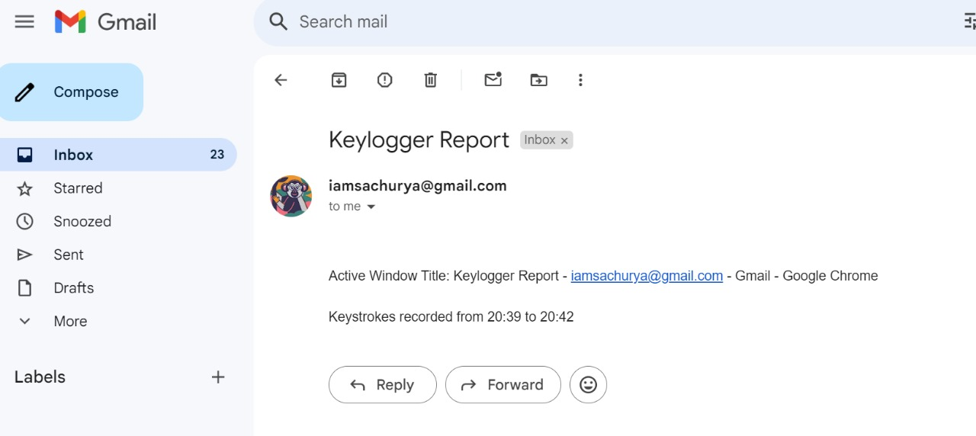
Results
Fig: Paillier Result

Slide 30
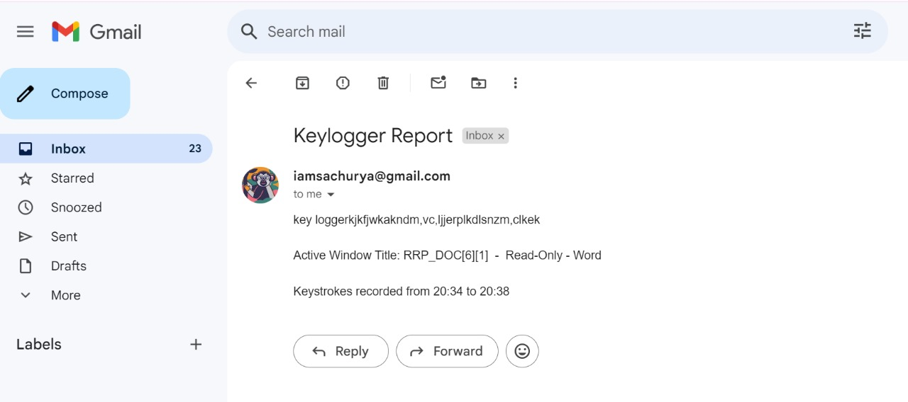
Results
Fig: BFV Algorithm

Slide 31
Conclusion
The innovative approach of homomorphic encryption has the potential to open new horizons for securely harnessing the power of cloud computing, data analytics, machine learning models, etc. Our project uses algorithms like Paillier, BFV, CKKS, and BGV to achieve this by ensuring to maintain data privacy and confidentiality. Homomorphic encryption holds immense potential for further development. Future advancements may include enhancing performance, integrating with cloud computing platforms, expanding support for additional operations and data types, and integrating with machine learning and data analytics, among other possibilities.
Notes:
31

Slide 32
Conclusion
The described keylogger project offers a sophisticated solution for monitoring and recording user activities on computer systems. Using Python and libraries like `pynput`, `smtplib`, `pyautogui`, and `OpenCV`, it logs keystrokes, timestamps, active window titles, and search queries. It also captures screenshots and user images during right-click events, sending secure email reports. This tool provides discreet and valuable insights into user interactions, ensuring comprehensive monitoring with features like keystroke logging, window tracking, search query logging, and media collection. Adhering to legal and ethical guidelines, the project aims to enhance digital security and protect user data, offering a thorough surveillance framework for understanding user behavior and preferences.
Jing Li, Xiaohui Kuang, Shujie Lin, Xu Ma, Yi Tang, “Privacy preservation for machine learning training and classification based on homomorphic encryption schemes”, 2020
M. Mohan, K. Devi, Jeevan Prakash, “Homomorphic encryption-state of the art”, 2017
K. K. Chauhan, A. K. S. Sanger, Ajai Verma, “Homomorphic Encryption for Data Security in Cloud Computing”, 2015
G. Chen, S. Chen, Y. Xiao, Y. Zhang, Z. Lin and T.H. Lai, “SgxPectre Attacks: Leaking Enclave Secrets via Speculative Execution”, 2018
J. Liu, M. Juuti, Y. Lu and N. Asokan, “Oblivious Neural Network Predictions via MiniONN Transformations”, pp. 619-631, 2017
Frederik Armknecht, Colin Boyd, Christopher Carr, Kristian Gjøsteen, Angela Jäschke, Christian A. Reuter, and Martin Strand, “A guide to fully homomorphic encryption”, IACR Cryptol. ePrint Arch.2015, 1192 (2015)

Slide 33
References
“A Systematic Literature Review on Windows Malware Detection Techniques”(2019) Authors: Karbab and Debbabi,Page(14-27).
“The Emerging Challenges of Wearable Biometric Cryptosystems”(2024) - Authors: Khalid Al Ajlan, Tariq Alsboui , Page(27-31).
“Multiple Time Servers Timed-Release Encryption Based on Shamir Secret Sharing for EHR Cloud System”(2024)Authors: Ke Yuan, Ziwei Cheng, Keyan Chen, Page(12-18).

